Slide 1

Querying Web API with OData

Slide 2
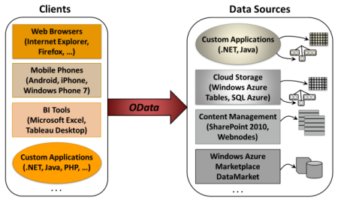
OData
OData = Open Data Protocol
Data Access Protocol for the Web
Provides a flexibility of creating and consuming quarriable REST services.
On demand data can be fetched from the server by the client over HTTP
Proposed by Microsoft in 2009. Standardised by OASIS in 2014
OData: An open protocol to allow the creation and consumption of queryable and interoperable RESTful APIs in a simple and standard way.
Notes:
Suppose our product table in the database contains more than 50000 products and we want to fetch only the top 50 products based on certain conditions like product id or price or name. As per our current implementation of the service, I’ll have to fetch all the products from the server database and filter them on client. Another option could be that I fetch the data at server only and filter the same and send the filtered data to client. In both the cases I am bearing the cost of writing extra code for filtering the data. Here is where OData comes into the picture. OData allows you to create services that are queryable. If the endpoints of the exposed services are OData enabled, or supports OData query options then the service implementation would consider the OData request and process it accordingly. So had that request for 50 records been an OData request, the service would have fetched only 50 records from the server. Not only filtering, but OData provides features like searching, sorting, skipping the data, selecting the data too. I’ll explain the concept with practical implementation. We’ll use our already-created service and modify them to be enabled for OData query options.

Slide 3
OData: Query Options
$orderby: Sorts the fetched record in particular order like ascending or descending.
$select: Selects the columns or properties in the result set.
$skip: Used to skip the number of records or results.
$top: Fetches only top n records.
$expand: Expands the related domain entities of the fetched entities.
$filter: Filters the result set based on certain conditions, it is like where clause of LINQ.
$inlinecount: This query option is mostly used for pagination at client side.

Slide 4
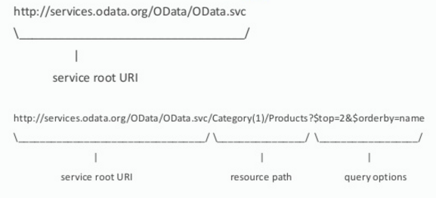
OData: Conventions

Slide 5
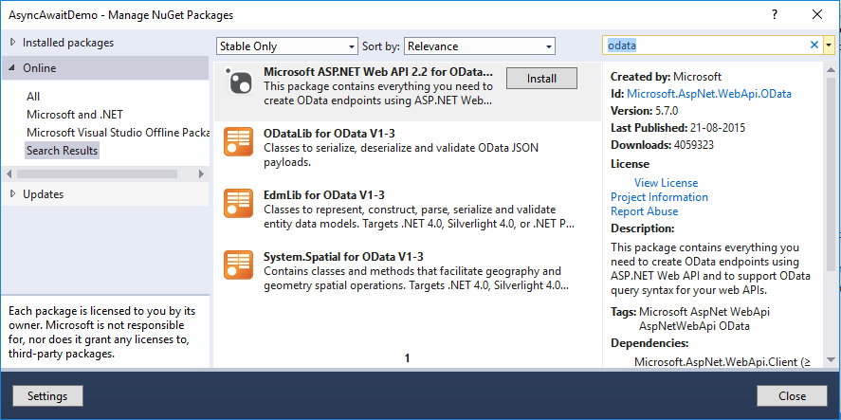
OData: Setup
Install OData Package from Nuget

Slide 6
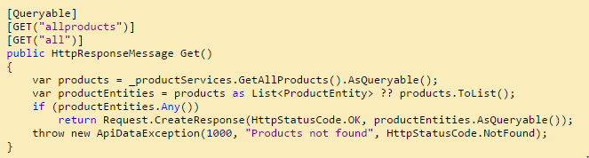
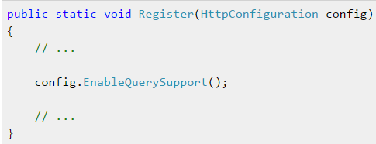
OData: Enable OData Query
Locally: Add [EnableQuery] attribute to the Get API Action Method
Make returned entities as AsQuaryable()
Globally:
[EnableQuery]
To enable OData query options globally, call EnableQuerySupport on the HttpConfiguration class at startup

Slide 7
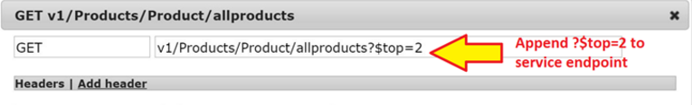
OData: $top
Fetches only the top two products from the service

Slide 8
OData: $skip
Omit first 3 records then fetch 5.
[Resource Path]/allproducts?$top=5&$skip=3
Use & to separate query options

Slide 9
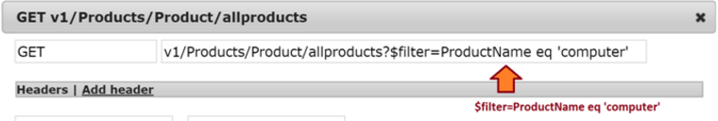
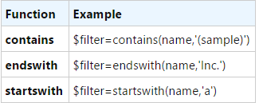
OData: $filter
Fetches all the products whose name equal to computer.
Return all products with id less than 3.
[Resource Path]/allproducts?$filter=ProductId lt 3
String functions: Return all products with "IPhone" in the name.
[Resource Path]/allproducts?$filter=substringof('IPhone',ProductName)

Slide 10
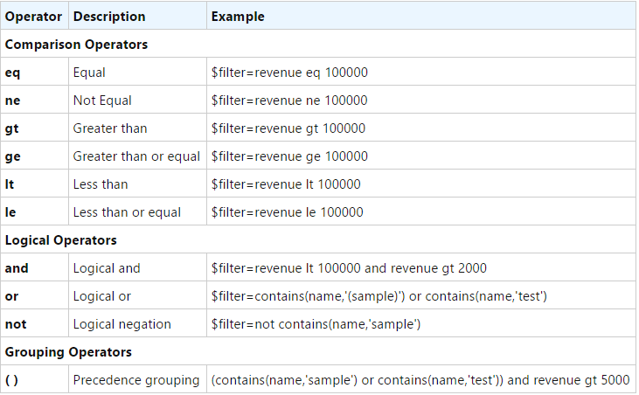
OData: Query Operators

Slide 11
OData: $orderby
Return all products with sorting on product name descending
[Resource Path]/allproducts?$orderby=ProductName desc
Return all products with sorting on product name ascending
[Resource Path]/allproducts?$orderby=ProductName asc
Return 5 expensive products
[Resource Path]/allproducts?$orderby=ProductPrice desc&$top=5
Use & to separate query options

Slide 12
OData: $select
Return all products with product name only
[Resource Path]/allproducts?$select=ProductName
Return all products with product name and price only
[Resource Path]/allproducts?$select=ProductName,Price
Use , to separate properties

Slide 13
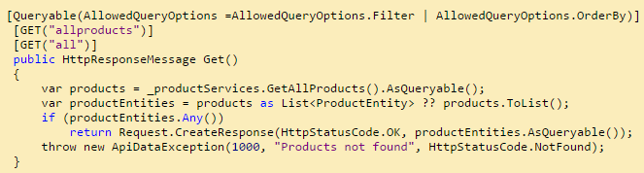
OData: Query Options Constraints
only $filter and $orderby queries are allowed on the API.
AllowedQueryOptions
Restrict client to use query options
[Queryable(AllowedQueryOptions =AllowedQueryOptions.Filter | AllowedQueryOptions.OrderBy)]

Slide 14
OData: Query Options Constraints
AllowedOrderByProperties
[Queryable(AllowedOrderByProperties = "ProductId")]
AllowedLogicalOperators
[Queryable(AllowedLogicalOperators = AllowedLogicalOperators.GreaterThan)]
AllowedArithmeticOperators
[Queryable(AllowedArithmeticOperators = AllowedArithmeticOperators.Add)]

